Slide 1
SALARY PREDICTION USING MACHINE LEARNING
CAPSTONE PROJECT
Presented By: Soumalya Ganguly
Student Name- Soumalya Ganguly
College Name- Mckv Institute of Engineering
Department- Computer Science & Engineering (CSE)

Slide 2
OUTLINE
Problem Statement (Should not include solution)
System Development Approach (Technology Used)
Algorithm & Deployment (Step by Step Procedure)
Result
Conclusion
Future Scope(Optonal)
References

Slide 3
Problem Statement
In today's competitive job market, determining a fair and accurate salary based on job-related features like experience, test scores, and interview performance is crucial. Manual evaluation can be subjective and inconsistent. This project aims to develop a machine learning model that predicts an individual's salary based on relevant input parameters to assist HR departments and recruitment platforms.

Slide 4
System Approach
System Requirements:
• Python 3.x
• Jupyter Notebook / VS Code
Libraries Used:
• pandas
• numpy
• matplotlib
• seaborn
• scikit-learn
Dataset Includes:
YearsExperience, Salary.

Slide 5
Algorithm & Deployment
Data Collection and Cleaning
Exploratory Data Analysis (EDA)
Feature Selection
Model Building using Linear Regression
Model Evaluation (MSE, MAE)
Prediction
Export Model using joblib for Deployment
Deploy using Streamlit (optional)

Slide 6
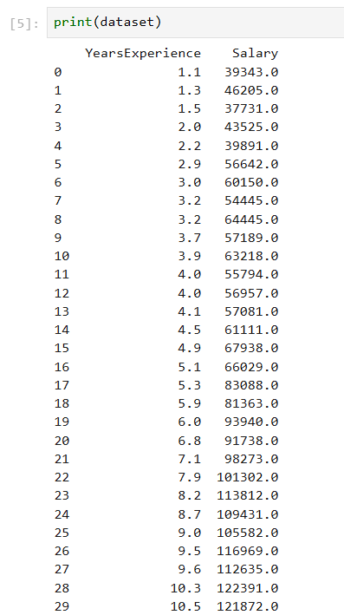
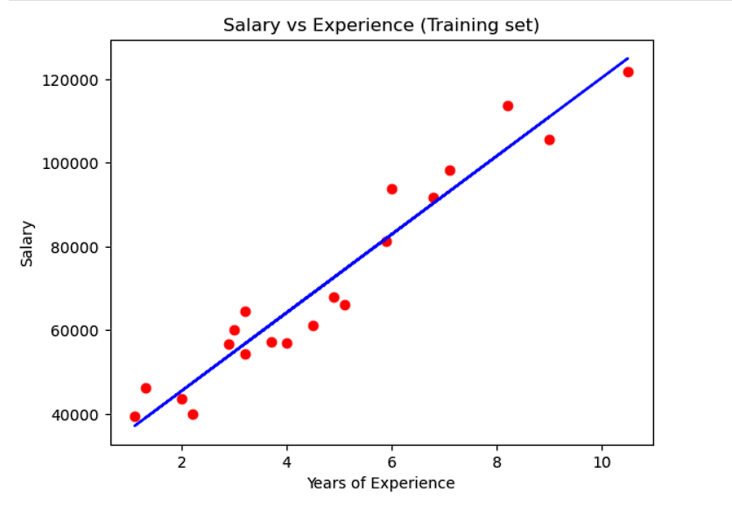
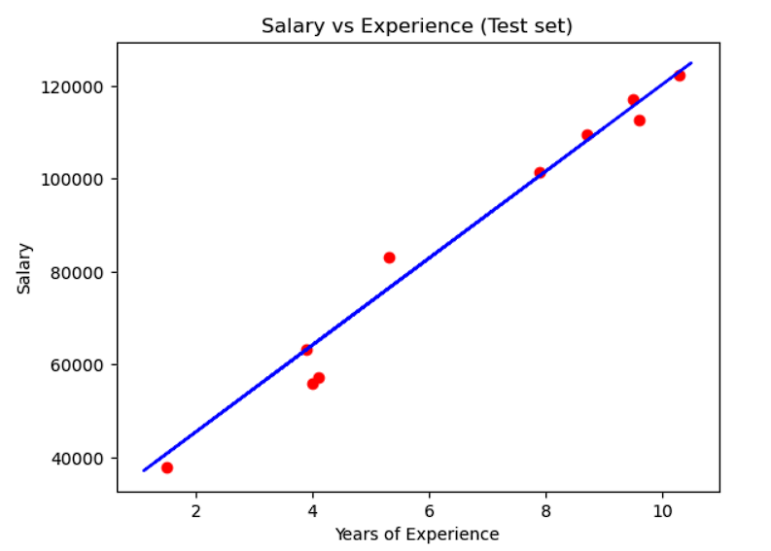
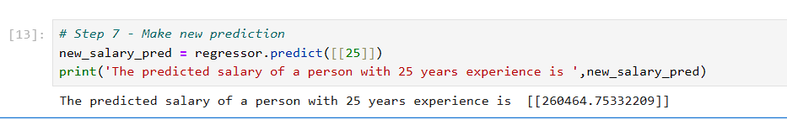
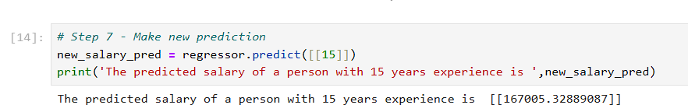
Result

Slide 7
Result
The model was trained using the provided dataset of 30 records. It achieved accurate predictions of salary based on experience.
Dataset Summary:
Mean Salary: ₹76,003
Standard Deviation: ₹27,414
GitHub Repository (placeholder): https://github.com/SOUMALYA-07CODER/Salary_predection-.git

Slide 8
Conclusion
The Salary Prediction model demonstrated how machine learning can assist in automating and improving the fairness of compensation decisions.
Challenges: • Small dataset size • Need for real-world data
Future Improvements: Using more complex models and integrating live user inputs.

Slide 9
Future scope(Optional)
Integrate with HR systems for real-time predictions.
Include additional features such as education level, location, and
domain expertise.
Deploy as a full web app for user interaction.

Slide 10
References
scikit-learn documentation
Python official docs
Towards Data Science articles
Dataset from Kaggle

Slide 11
THANK YOU

